Slide 1
Local transport strategy 2024-2040
Our journey to be healthier,
more sustainable and better connected

Slide 2
Today
Why change
Movement and Place Plans
What comes next
Questions

Slide 3
It’s “the right” thing to do
Improving air quality
Tackling health inequalities
Opportunities for increasing physical activity
“One of the greatest single public health interventions any city can make is to prioritise people above cars – very few other actions simultaneously benefit individual, community and planetary health.” Peter Roderick, Director for Public Health, City of York Council

Slide 4
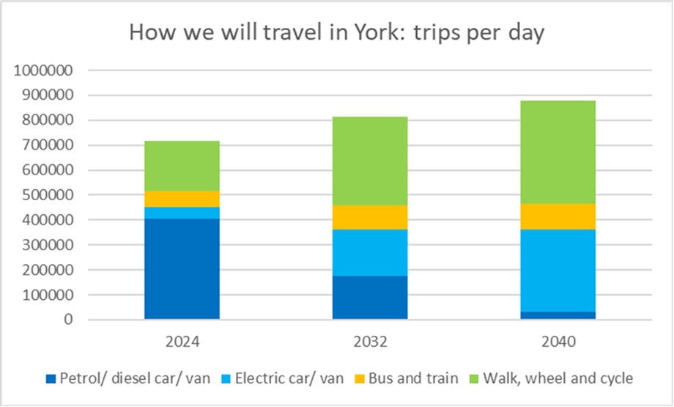
Technical reason: York is growing

Slide 5
Responding to public engagement

Slide 6
Change is already happening...
York Station Gateway
Haxby Station planning app
York Outer Ring Road
Bus Service Improvement Plan

Slide 7
New governance and funding arrangements
Mayor and devolution
Key road network
Local Plan
Respond to Kings Speech priorities
Local Transport Fund (from HS2 cancellation)

Slide 8
Movement and Place
Decide and provide not predict and provide
Reducing traffic by 20% by 2030 is critical
Enable by changes to both movement – but also place
How we provide “places” enables sustainable transport use
Complementary projects – districts, neighbourhoods and corridors
Everywhere in York – villages, suburbs, city centres, large employers etc
How we work across the Council – health, regeneration, transport etc

Slide 9
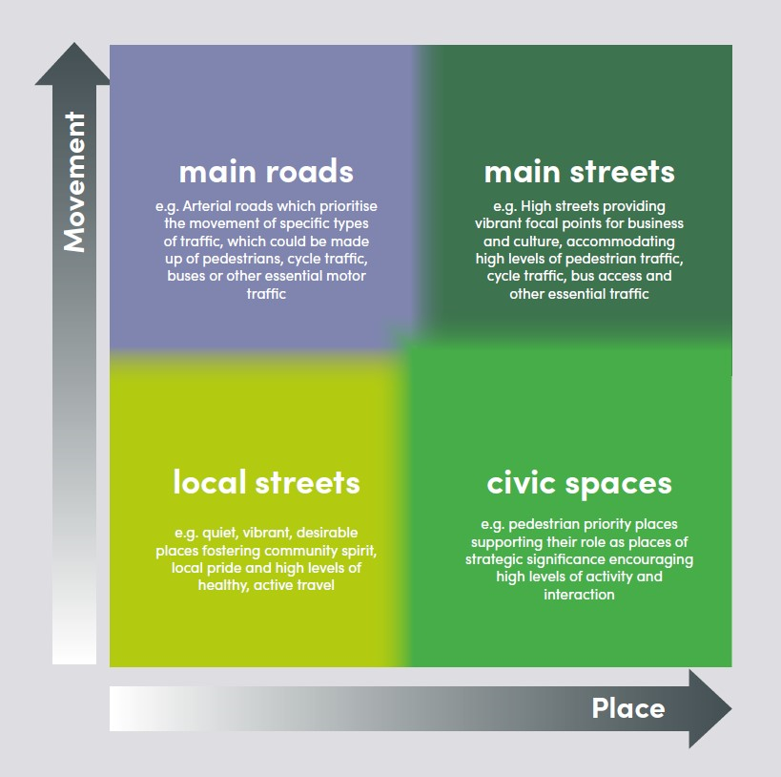
Movement and Place

Slide 10
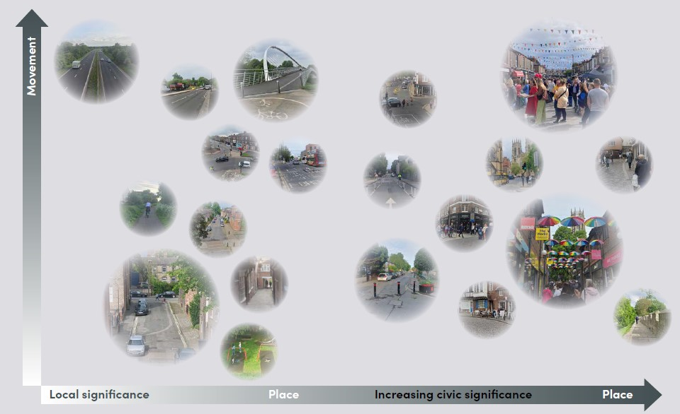

Slide 11
Public Transport Policies
Policy Focus Area 4: Improving public transport
Our Vision for Improving Public Transport is:
“We will improve public transport so that all areas of the city have good and reliable public transport access. Key to this will be extending the bus network, ensuring effective and reliable early and late services when people need them, and upgrading high frequency bus services – in some cases into bus rapid transit services or possibly light rail transit systems. We will also work to upgrade heavy rail services where they play a local role or support our other policies. Not only will this result in a 50% or greater increase in bus patronage by 2030, it will also enhance the viability of public transport and protect its future.”
This vision is supported by 88% of respondents to Our Big Transport Conversation.
Our policies
Policy 4.1 – Work with bus operators to create a comprehensive network of bus services, accessible to as many residents and visitors as possible, and providing services at weekends and for the night-time economy. Seek funding for and set challenging targets for increased bus network coverage, and ensure that all low-income areas are appropriately served. Ensure that all new development (10 or more dwellings) are designed for bus access, with appropriate service frequencies provided as early as possible after first occupancy. Consider alternative models of service provision (e.g. franchising) if it is not possible to achieve the desired network of services commercially.
Policy 4.2 - Use infrastructure design and network management to increase the reliability and efficiency of bus services. Set challenging targets for increased bus reliability. As a first step, develop a proposal for a dedicated priority route for buses (as part of the Movement and Place plan – see policy focus area 6), and other sustainable transport, across the city centre, including effective enforcement of existing regulations in Piccadilly and Pavement.

Slide 12
Public Transport Policies
Policy 4.3 – Work with local communities to obtain funding to develop community transport schemes such as community minibuses, dial-a-ride and car clubs and share schemes, particularly to fill any gaps in the bus network. Consider the introduction of a shuttle bus in the footstreets area of the city centre.
Policy 4.4 – Work with Park & Ride operators to deliver an enhanced commercially viable service with the aim of increasing the use of Park & Ride buses, and develop Park and Ride sites as access hubs for local communities and villages and for inter-urban buses and coaches. Use all tools available including infrastructure design, network management, route planning and car parking charges to drive up patronage and maximise the reliability and efficiency of the Park and Ride services.
Policy 4.5 – Develop a rail strategy to guide the approach to rail investment and priorities within York, with the aim of increasing passenger numbers on rail services and identifying opportunities for enhanced or new routes and services.
Policy 4.6 – Ensure that the redesign of the Railway Station makes it more sustainable, better able to support walking, wheeling, cycling and buses, and less dependent on car access. Ensure that Poppleton and the proposed station at Haxby are at the centre of effective walk/ wheel/ cycle/ bus networks.
Policy 4.7 – Enable multi-modal journeys, using all opportunities to improve interchange facilities across the bus network (such as cycle parking provision and shelters) and work with stakeholders to explore multi-operator ticketing, and provision for cycles, wheelchairs and mobility aids on buses and trains.
Policy 4.8 – Develop an integrated fares policy for all road-based public transport which encourages and rewards frequent use and makes bus use affordable for young people and low-income households.
Policy 4.9 – Work with the taxi/ private hire trades to encourage greater provision of wheelchair accessible, low emission vehicles in York.
Policy 4.10 – Consider the scope for providing water-based access to York city centre – e.g. using the existing tour boat service or water taxis – to provide an attractive alternative to driving into York for visitors.

Slide 13
What is next
July
Executive
Autumn
Executive
Delivery of ‘quick wins’
Our journey to a healthier, more sustainable and
better-connected city : delivered via the Movement & Place Plan

Slide 14
Bus Schemes
As set out in BSIP - provides funding.
Ongoing/ other funding currently uncertain
In addition to what has been seen already – network electrification/ information, stops and shelters/ tap on/ off
Revenue – continuation of current young peoples’ fares and network support
City Centre Sustainable Transport Route
Park and ride development
Radial priorities and development sites

Slide 15
Thank you - any questions?

